Slide 1
Group 11 Disease Solutions
MICHAEL WANG, JULIA MONTI, KARUNA SRIVASTAVA,
RICHARD AMAYO, MRUNMAYI DANDEKAR
Notes:
Hello everyone. We are the Disease Solutions team.

Slide 2
Agenda
Project Overview
Methodology
Solution
Conclusion
Notes:
Today, we will give you a brief overview of the project and the problem we are aiming to solve, our methodology to reach our solution, the solution itself, and then wrap up with the conclusion.

Slide 3
Project Overview

Slide 4
Objectives
1
2
3
Create an automated process that simulates multiple disease spreads throughout population of West Lafayette and Lafayette
Aid public policy officials in devising flexible and effective policy strategies to mitigate the spread of pandemic diseases
Determine the costs associated with choices regarding implementing policy strategies
Notes:
The objectives of our work were to simulate multiple disease spreads through the population of the Greater Lafayette area, identify policies to mitigate the effects of those spreads, and determine the costs associated with those choices.

Slide 5
Methodology
Notes:
Now I’ll pass it off to Michael to explain how we set out to meet those objectives.

Slide 6
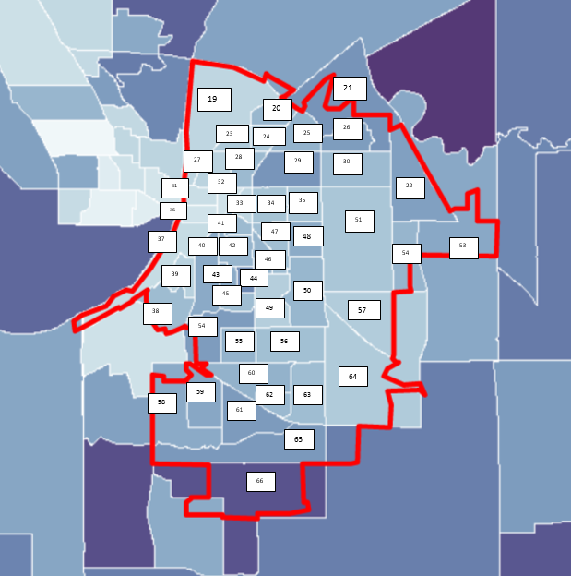
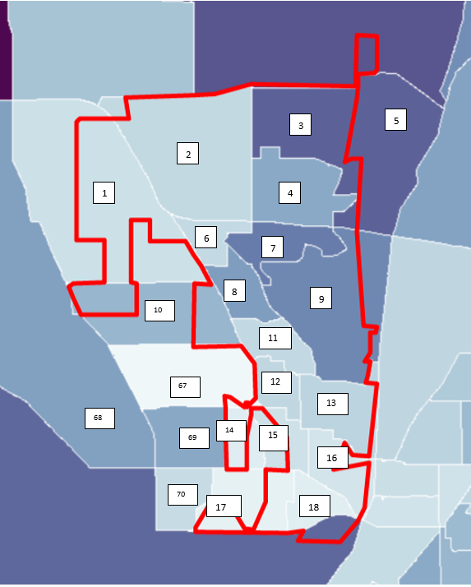
Population Simulation
BASED ON REGIONAL DEFINITIONS
Notes:
To start off, we collected region-specific data on the 70 different regions of West Lafayette and Lafayette shown on the right. This data was used simulate individuals and households in the area.

Slide 7
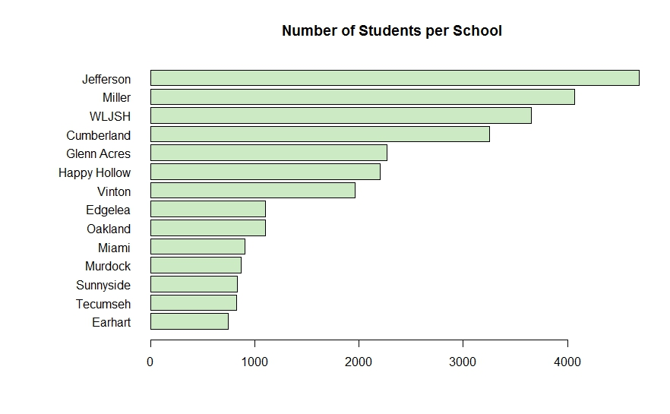
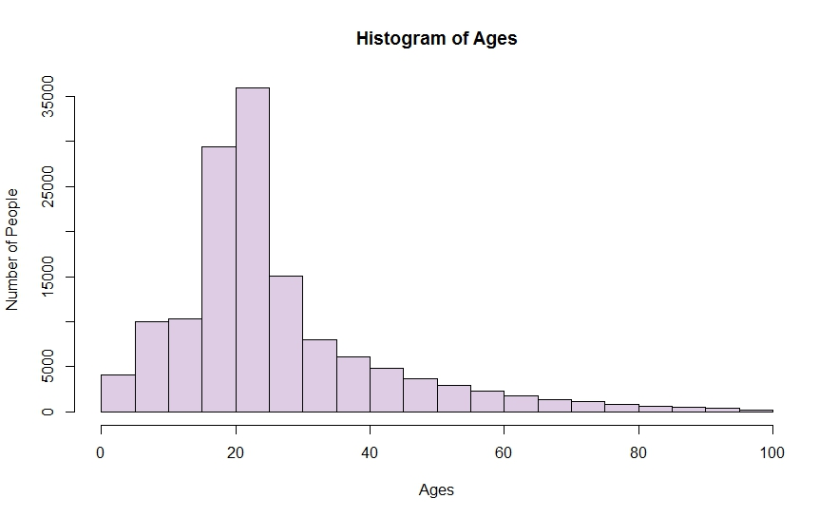
Population Simulation
STATISTICS ON INDIVIDUALS:
DATE OF BIRTH
SEX
WORKPLACE
SCHOOL
Notes:
For individuals, the simulation included information about their date of birth, sex, employment status and workplace, and schools attended.

Slide 8
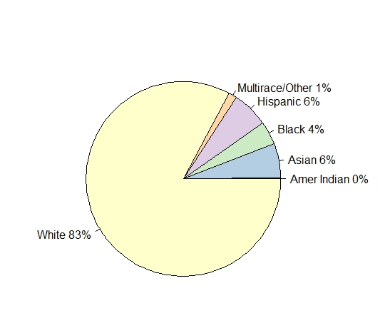
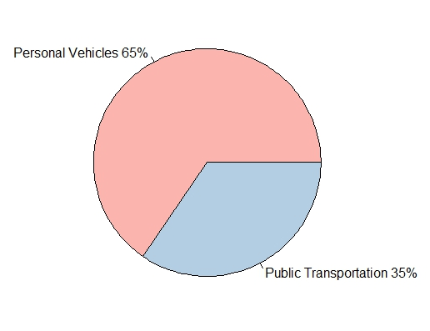
Population Simulation
STATISTICS ON HOUSEHOLDS:
RACE
PUBLIC TRANSPORTATION USAGE
HOUSEHOLD INCOME
Notes:
For households, information kept on them included the most prominent race, public transportation usage, and total household income. The factors for both individuals and households were tracked due to their impact on disease spread.

Slide 9
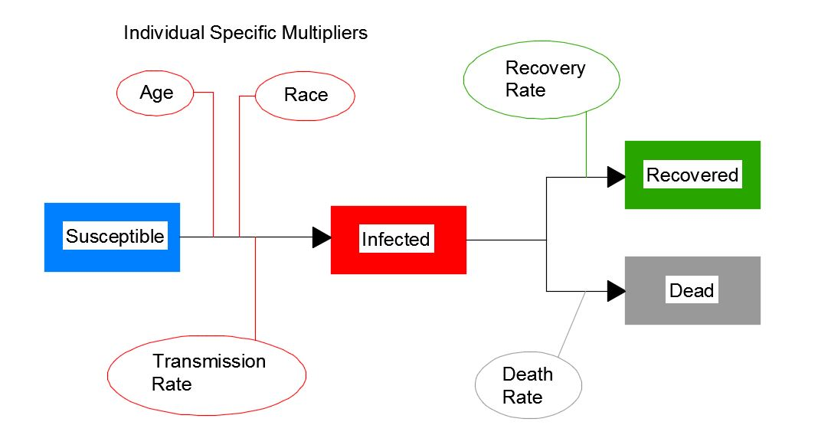
Disease Spread Model
Notes:
Speaking of which, this product utilized a SIR(D) model for such spreads. How this worked was that all those not initially infected were susceptible to a unique transmission rate, dependent on factors such as their age and race, by which they could be infected. After infection, each individual could either recover or pass away from their disease, which was dependent on their own rates. (Michael had a much better explanation for this but I’m just trying to get the main ideas so he can fix it later.)

Slide 10
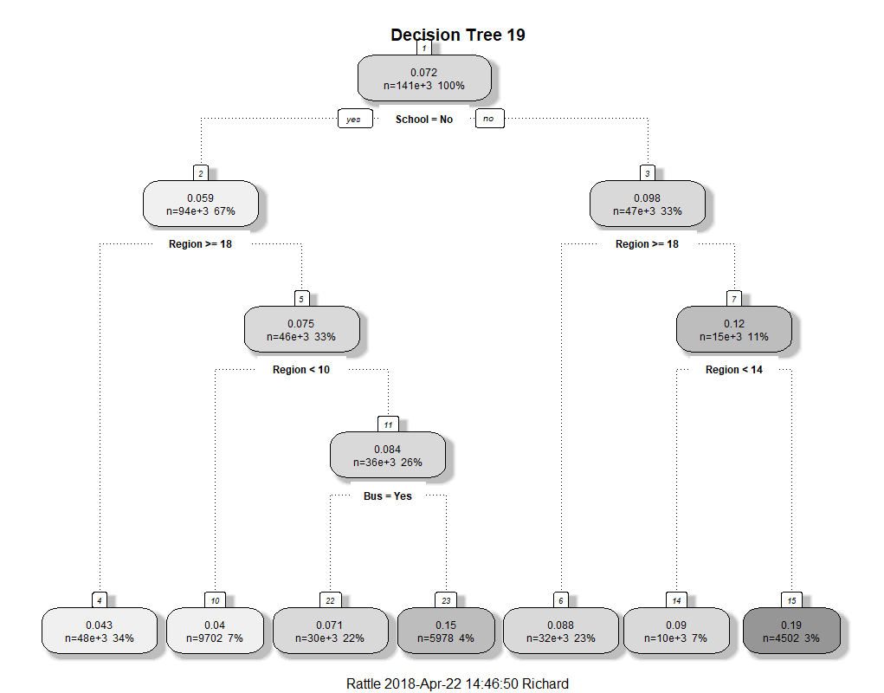
Intelligent Decision Making
Notes:
The results of the disease spreads I just described were captured through diagrams similar to what you see on the left, where the blue line represents those susceptible, red indicates those who are infected, green shows those recovered, and black represents those who are unlucky.
The results of the disease spread were analyzed using machine learning to identify common factors among the most contagious patients to target with intelligent policy responses to mitigate disease spread.

Slide 11
Solution
Notes:
Now I will hand it off to Karuna to cover our proposed solution.

Slide 12
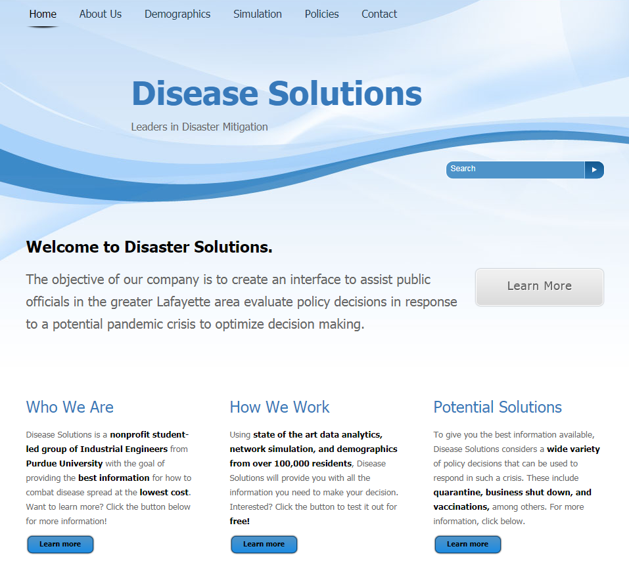
Interactive Website Interface
Features of Note:
Dynamic Demographic Descriptions
Disease Spread Simulation
Policy Recommendations and Cost Analysis
Notes:
To help public officials make the best informed decisions we have an interactive web interface. The most important features of which are the dynamic demographic descriptions, disease spread simulation, and policy recommendations and costs analysis.

Slide 13
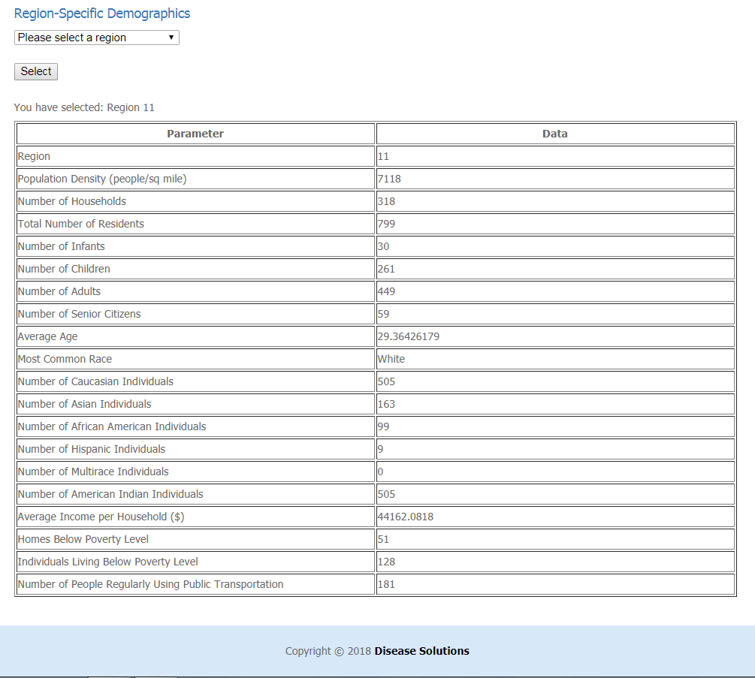
Dynamic Demographic Descriptions
Region-Specific Information:
Count of Households and Individuals
Classification of Infants, Children, Adults, and Senior Citizens
Race Distributions
Income and Poverty Breakdown
Notes:
For the officials to understand the impact and cost of implementing policies we thought it was important to have a demographics tab that allows users to request information about the number of household and individual, details of age groups and race distributions, and income and poverty statistics for any region.

Slide 14
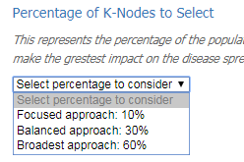
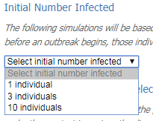
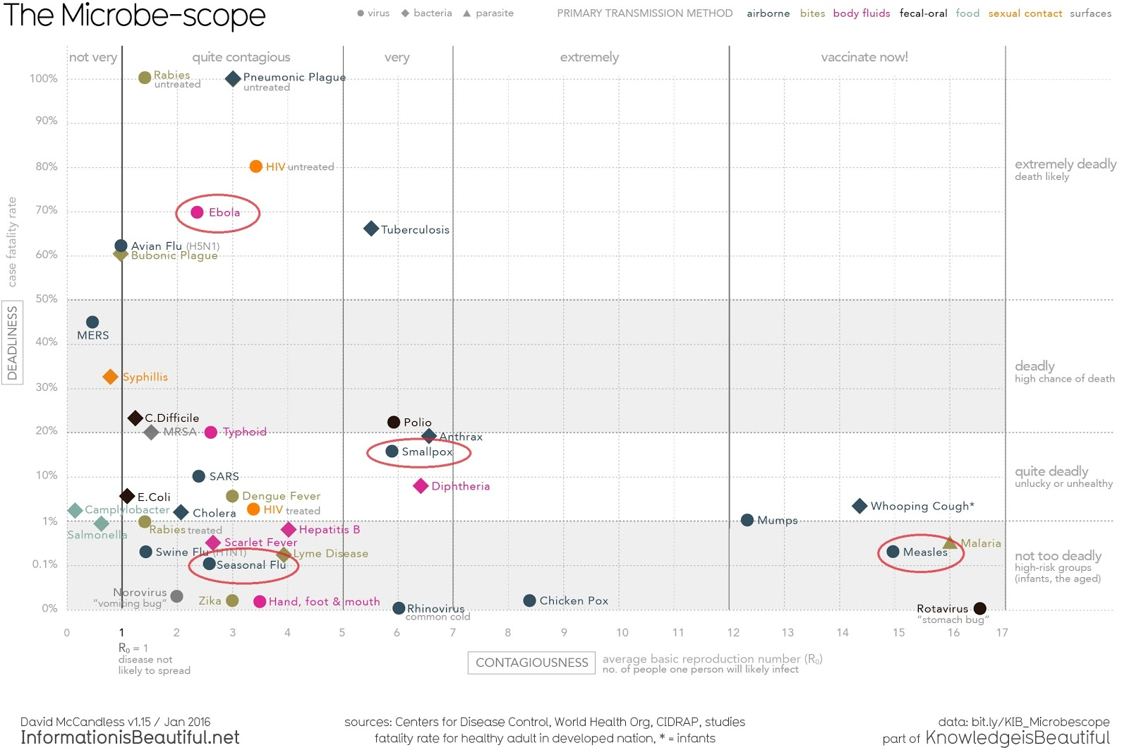
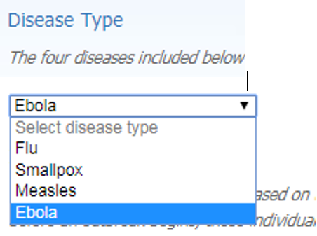
Simulation Inputs
Notes:
For the simulation aspect of the solution, users have the opportunity to customize three parameters of the design: disease type, which includes well-known diseases for ease of use. these four diseases have different transmission rates and death rates as you can see in this graph. The second option in the number of individuals initially infected to account for varying degrees of difficulty in identifying and containing the disease initially, and the last is the percentage of people they would like their policy to target. Now I’ll pass it over to Julia to explain the results.

Slide 15
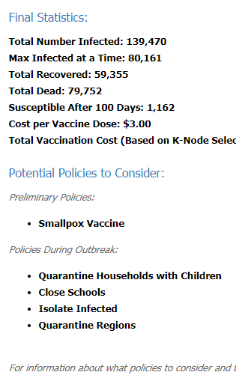
Disease Spread Simulation Results
Important Features
➢Descriptions of susceptibility, infection, recovery, and death at the end of each 100 day simulation
➢Identification of policies targeted to mitigate disease spread
➢Cost estimate of preliminary actions based on customization
Notes:
For each of the 36 potential disease spreads included on the website, the user is shown a tailored SIRD graph and decision tree as shown on slide 10 to explain the spread over time and what policies were impactful, as well as the descriptions of the state of the population after 100 days, what policies would best combat that future state, and cost estimates of preliminary measures

Slide 16
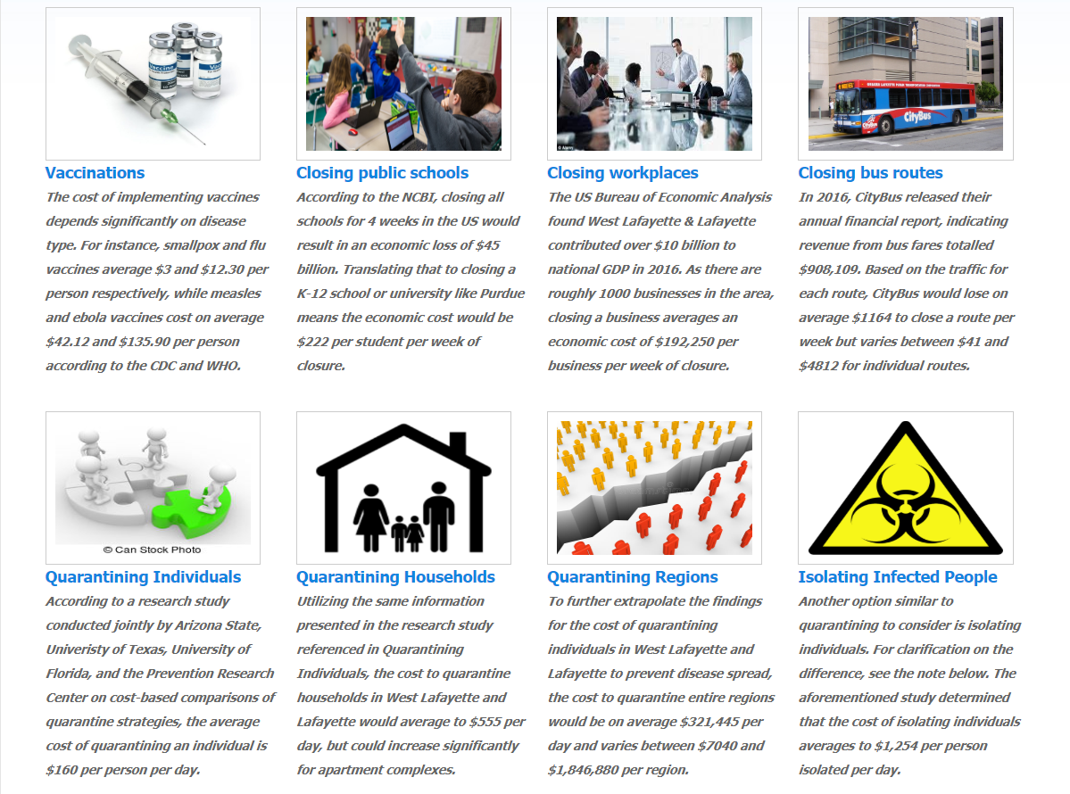
Policy Cost Analysis
Policy Name | Average Costs
Flu Vaccine | $12.30/treatment
Smallpox Vaccine | $3.00/treatment
Measles Vaccine | $42.12/treatment
Ebola Vaccine | $135.90/treatment
Closing Public Schools | $222/student/ week
Closing Workplaces | $192,250/ business/week
Closing Bus Routes | $1164/route/week
Quarantine Individuals | $160/person/day
Quarantine Households | $555/household/day
Quarantine Regions | $321,445/region/day
Isolating Infected People | $1,254/person/day
Notes:
For further information on available policy decisions, users are directed to the policies tab, where all 8 of our considered policies are outlined. As summarized by the table to the left of the screen, public officials are also provided with the average costs of implementing a policy in their constituency as well as the variance that exists among regions to evaluate the economic costs of their decisions.

Slide 17
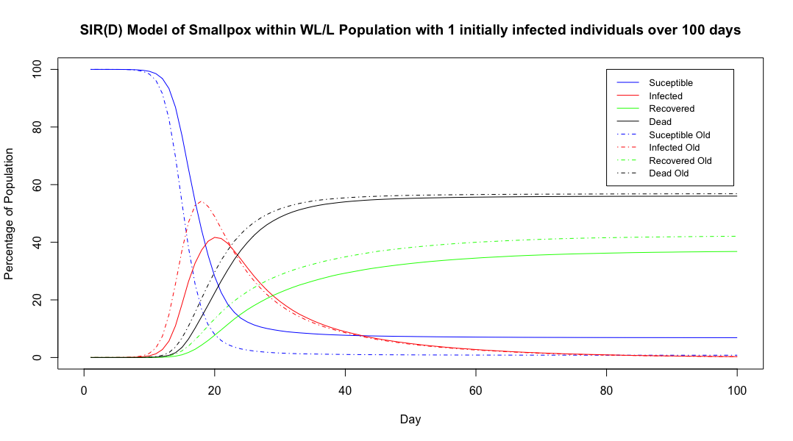
Policy Impact
Implemented vaccination policy
Saves 20,000 lives
Prevents 40,000 infections
Notes:
To prove the validity of our concept, we also include a demonstration of the impact of potential policies on our population. In this example, utilizing smallpox vaccines on just a fraction of the population saves 20,000 lives and prevents 40,000 infections, illustrating just how important this can be for future pandemics. Now I will hand it over to Richard to wrap up.

Slide 18
Conclusion

Slide 19
Conclusion
The West Lafayette and Lafayette area is in need of a technological solution to aid policymakers in preparing for potential pandemic outbreaks
This solution meets that need by
Simulating multiple disease spreads through the area
Determining flexible and effective policies to mitigate disease impact
Calculates the costs associated with implementing policies
Notes:
To wrap up, DS is focused on providing new and innovative solutions to aid policymakers through interactive simulation of pandemic outbreak; coupled with recommended policy and a method to evaluate their cost. Thank you for your time, we are your solution.

